Slide 2
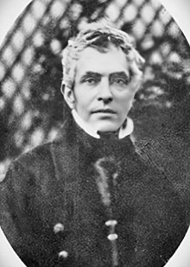
1800 - 1892
John Nelson Darby – Father of Dispensationalism
Irish Pastor of the “Plymouth Brethren”
Popularized premillennialism in 1830

Slide 3
PREMILLENNIALISM
A period of either 3 ½ or 7 years of trouble, tribulation on the earth is then followed by Christ returning to the earth to set up a 1000 year reign where He will rule with His saints over the earth.

Slide 4
CHICAGO:
1896 Moody Bible Institute adopted the teachings
Dwight L. Moody the first premillennialist preacher
1909 C.I. Scofield:
published his own Bible w/notes about tribulation

Slide 5
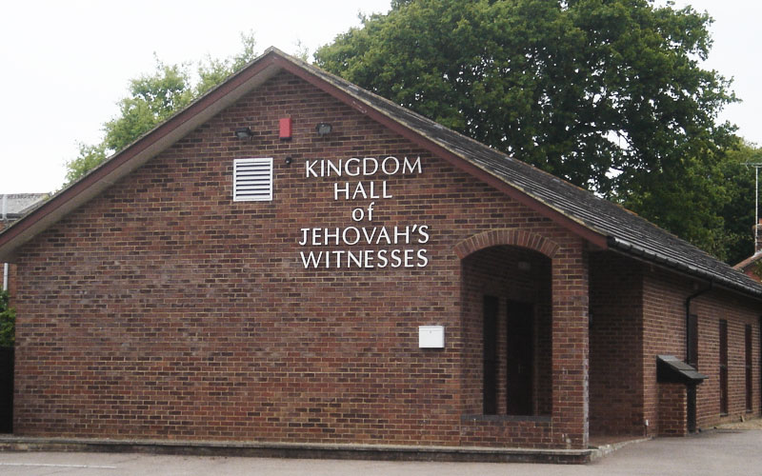
Founder:
J.F. Rutherford
Predicted we would
confidently see the return of Abraham, Isaac, David on the earth in 1925.

Slide 6
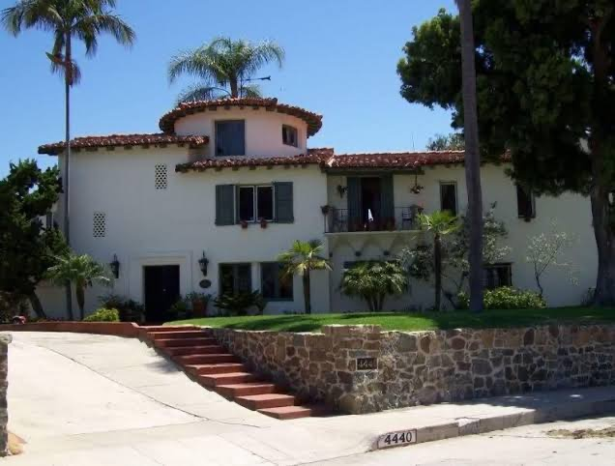
Beth Sarim (House of Princes)

Slide 7
The Late Great Planet Earth – Hal Lindsay

Slide 8
The Late Great Planet Earth – Hal Lindsay
“Left Behind” book series by LaHaye & Jenkins

Slide 9
The Late Great Planet Earth – Hal Lindsay
“Left Behind” book series by LaHaye & Jenkins
2 popular movies “A Thief in The Night”
Video games about the Rapture

Slide 10
Post-Tribulational Premillennialism
2nd coming Judgment
Tribulation Millennial Reign
7 yrs 1000 yrs

Slide 11
Post-Tribulational Premillennialism
2nd coming Judgment
Tribulation Millennial Reign
Pre-Tribulational Premillenialism
1st 2nd coming 2nd 2nd coming Judgment
Tribulation Millennial Reign
7 yrs. 1000 yrs.

Slide 12
The “Last Day”
John 6:39 – “…I will raise him up in the last day.”
6:40 – “…raise him up at the last day”
6:44 – “…raise him up at the last day”
6:54 – “…raise him up at the last day”

Slide 13
The “Last Day”
John 11:24 – “I know that he will rise again…
in the last day.”

Slide 14
The “Last Day”
John 11:24 – “I know that he will rise again…
in the last day.”
John 12:48 – “The word that I have spoken will judge him in the last day.”

Slide 15
Matt 24
Destruction
of
Jerusalem
v. 36
2nd Coming
vs 40,41
“One taken…
One left.” ?

Slide 16
Matt 24 1 Thess. 4: 16,17
Destruction * Lord receiving His own
of * Meet Him in the air
Jerusalem * Will always be w/ Him
v. 36 (NO RETURN)
2nd Coming
vs 40,41
“One taken…
One left.” ?

Slide 17
3 Reasons NOT to believe in Premillennialism

Slide 18
3 Reasons NOT to believe in Premillennialism
1) It’s not historic, not in any teaching, writing before c. 1830

Slide 19
3 Reasons NOT to believe in Premillennialism
1) It’s not historic, not in any teaching, writing before c. 1830
2) Apostle Paul said 2nd coming would be loud
and just once (1 Thess 4:16ff; 1 Cor. 15:50ff)

Slide 20
3 Reasons NOT to believe in Premillennialism
1) It’s not historic, not in any teaching, writing before c. 1830
2) Apostle Paul said 2nd coming would be loud
and just once (1 Thess 4:16ff; 1 Cor. 15:50ff)
3) Jesus did not teach it

