Slide 2
Elders - Bishops - Pastors

Slide 3
Elders - Bishops - Pastors
Acts 20:17,28 “…called for the elders of the church…
…take heed to yourselves and to all the flock, which the Holy Spirit has made you overseers, to shepherd the church of God…”

Slide 4
Elders - Bishops - Pastors
Acts 20:17,28 “…called for the elders of the church…
…take heed to yourselves and to all the flock, which the Holy Spirit has made you overseers, to shepherd the church of God…”
Elder – presbuteros (gk) = older man
Bishop – episkopos (gk) = to watch over, overseer
Pastor – poimen (gk) = to feed, protect, shepherd

Slide 5
Elders - Bishops - Pastors
1 Peter 5:1,2 “The elders who are among you I
exhort…Shepherd the flock of God which is among you, serving as overseers…”

Slide 6
Elders - Bishops - Pastors
1 Peter 5:1,2 “The elders who are among you I
exhort…Shepherd the flock of God which is among you, serving as overseers…”
Elder – presbuteros (gk) = older man
Pastor – poimen (gk) = to feed, protect, shepherd
Bishop – episkopos (gk) = to watch over, overseer

Slide 7
Acts 20:17,28 - 1 Peter 5:1-3
These passages describe an older man who is entrusted with the feeding & protection of the members of the local congregation.

Slide 8
“Obey those who rule (lead) over you, and be submissive, for they watch out for your souls, as
those who must give an account. Let them do so
with joy and not grief, for that would be unprofitable for you”
- Hebrews 13:17

Slide 9
“Obey those who rule (lead) over you, and be submissive, for they watch out for your souls, as
those who must give an account. Let them do so
with joy and not grief, for that would be unprofitable for you”
- Hebrews 13:17

Slide 10
Acts 20:17,28 - 1 Peter 5:1-3 - Hebrews 13:17
These passages describe an older man who is entrusted with the feeding & protection of the members of the local congregation. A man who is held accountable by God for the spiritual well-being and growth of each soul who is joined to, and identifies with that congregation the elder watches over.

Slide 11
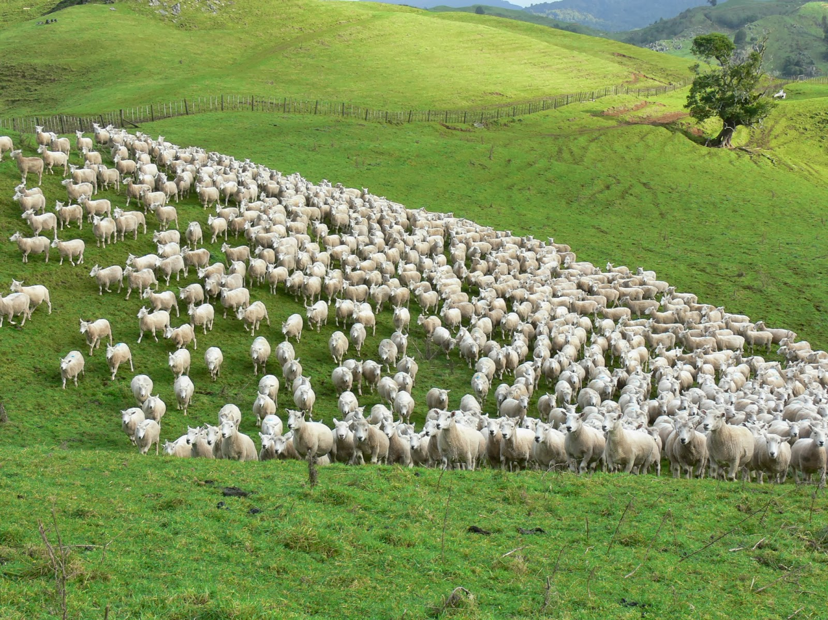
Elder’s Responsibilities to the Flock (congregation)

Slide 12
Elder’s Responsibilities to the Flock (congregation)
Take heed to themselves – Acts 20:28

Slide 13
Elder’s Responsibilities to the Flock (congregation)
Take heed to themselves – Acts 20:28
Take heed to the flock – Acts 20:28; Hebrews 13:17

Slide 14
Elder’s Responsibilities to the Flock (congregation)
Take heed to themselves – Acts 20:28
Take heed to the flock – Acts 20:28; Hebrews 13:17
Feed the flock – Acts 20:28; 1 Peter 5:2

Slide 15
Elder’s Responsibilities to the Flock (congregation)
Take heed to themselves – Acts 20:28
Take heed to the flock – Acts 20:28; Hebrews 13:17
Feed the flock – Acts 20:28; 1 Peter 5:2
Protect the flock – Acts 20:28; 1 Peter 5:2

Slide 16
Elder’s Responsibilities to the Flock (congregation)
Take heed to themselves – Acts 20:28
Take heed to the flock – Acts 20:28; Hebrews 13:17
Feed the flock – Acts 20:28; 1 Peter 5:2
Protect the flock – Acts 20:28; 1 Peter 5:2
Be examples – 1 Peter 5:3; Hebrews 13:17

Slide 17
Elder’s Responsibilities to the Flock (congregation)
Take heed to themselves – Acts 20:28
Take heed to the flock – Acts 20:28; Hebrews 13:17
Feed the flock – Acts 20:28; 1 Peter 5:2
Protect the flock – Acts 20:28; 1 Peter 5:2
Be examples – 1 Peter 5:3; Hebrews 13:17
Be hospitable – 1 Timothy 3:2; 1 Peter 4:9

Slide 18
Elder’s Responsibilities to the Flock (congregation)
Take heed to themselves – Acts 20:28
Take heed to the flock – Acts 20:28; Hebrews 13:17
Feed the flock – Acts 20:28; 1 Peter 5:2
Protect the flock – Acts 20:28; 1 Peter 5:2
Be examples – 1 Peter 5:3; Hebrews 13:17
Be hospitable – 1 Timothy 3:2; 1 Peter 4:9
Support the weak – Acts 20:35

Slide 19
Elder’s Responsibilities to the Flock (congregation)
Take heed to themselves – Acts 20:28
Take heed to the flock – Acts 20:28; Hebrews 13:17
Feed the flock – Acts 20:28; 1 Peter 5:2
Protect the flock – Acts 20:28; 1 Peter 5:2
Be examples – 1 Peter 5:3; Hebrews 13:17
Be hospitable – 1 Timothy 3:2; 1 Peter 4:9
Support the weak – Acts 20:35
Pray for the sick – James 5:14

Slide 20
Elder’s Responsibilities to the Flock (congregation)
Take heed to themselves – Acts 20:28
Take heed to the flock – Acts 20:28; Hebrews 13:17
Feed the flock – Acts 20:28; 1 Peter 5:2
Protect the flock – Acts 20:28; 1 Peter 5:2
Be examples – 1 Peter 5:3; Hebrews 13:17
Be hospitable – 1 Timothy 3:2; 1 Peter 4:9
Support the weak – Acts 20:35
Pray for the sick – James 5:14
Hold fast the word – Titus 1:9

Slide 21
Elder’s Responsibilities to the Flock (congregation)
Take heed to themselves – Acts 20:28
Take heed to the flock – Acts 20:28; Hebrews 13:17
Feed the flock – Acts 20:28; 1 Peter 5:2
Protect the flock – Acts 20:28; 1 Peter 5:2
Be examples – 1 Peter 5:3; Hebrews 13:17
Be hospitable – 1 Timothy 3:2; 1 Peter 4:9
Support the weak – Acts 20:35
Pray for the sick – James 5:14
Hold fast the word – Titus 1:9
Admonish, exhort, convict – 1 Thess. 5:12; Titus 1:9

Slide 22
Elder’s Responsibilities to the Flock (congregation)
Take heed to themselves – Acts 20:28
Take heed to the flock – Acts 20:28; Hebrews 13:17
Feed the flock – Acts 20:28; 1 Peter 5:2
Protect the flock – Acts 20:28; 1 Peter 5:2
Be examples – 1 Peter 5:3; Hebrews 13:17
Be hospitable – 1 Timothy 3:2; 1 Peter 4:9
Support the weak – Acts 20:35
Pray for the sick – James 5:14
Hold fast the word – Titus 1:9
Admonish, exhort, convict – 1 Thess. 5:12; Titus 1:9
Stop mouths of subversive/idle talk – Titus 1:10,11

Slide 23
Elder’s Responsibilities to the Flock (congregation)
Take heed to themselves – Acts 20:28
Take heed to the flock – Acts 20:28; Hebrews 13:17
Feed the flock – Acts 20:28; 1 Peter 5:2
Protect the flock – Acts 20:28; 1 Peter 5:2
Be examples – 1 Peter 5:3; Hebrews 13:17
Be hospitable – 1 Timothy 3:2; 1 Peter 4:9
Support the weak – Acts 20:35
Pray for the sick – James 5:14
Hold fast the word – Titus 1:9
Admonish, exhort, convict – 1 Thess. 5:12; Titus 1:9
Stop mouths of subversive/idle talk – Titus 1:10,11
Rule well (“to stand before” lead) – 1 Timothy 3:4-5; 5:17

Slide 24
Member’s Responsibilities to the Elders

Slide 25
Member’s Responsibilities to the Elders
1 Thessalonians 5:12,13
1) To recognize (acknowledge) them
2) Esteem them highly in love

Slide 26
Member’s Responsibilities to the Elders
1 Thessalonians 5:12,13
1) To recognize (acknowledge) them
2) Esteem them highly in love
1 Timothy 5:19
3) Do not receive an accusation against an elder
(except from 2 or 3 witnesses)

Slide 27
Member’s Responsibilities to the Elders
1 Thessalonians 5:12,13
1) To recognize (acknowledge) them
2) Esteem them highly in love
1 Timothy 5:19
3) Do not receive an accusation against an elder
(except from 2 or 3 witnesses)
Hebrews 13:7
4) Remember the example of their: Faith and Life

Slide 28
Member’s Responsibilities to the Elders
1 Thessalonians 5:12,13
1) To recognize (acknowledge) them
2) Esteem them highly in love
1 Timothy 5:19
3) Do not receive an accusation against an elder
(except from 2 or 3 witnesses)
Hebrews 13:7
4) Remember the example of their: Faith and Life
Hebrews 13:17
5) Obey them 6) Be submissive 7) Be cooperative

Slide 30
“And Jesus went throughout all the cities and villages, teaching…and healing every disease. When He saw the crowds, he had compassion for them because they were harassed and helpless (weary and scattered),
like sheep without a shepherd.”
- Matthew 9:35,36

