Slide 1
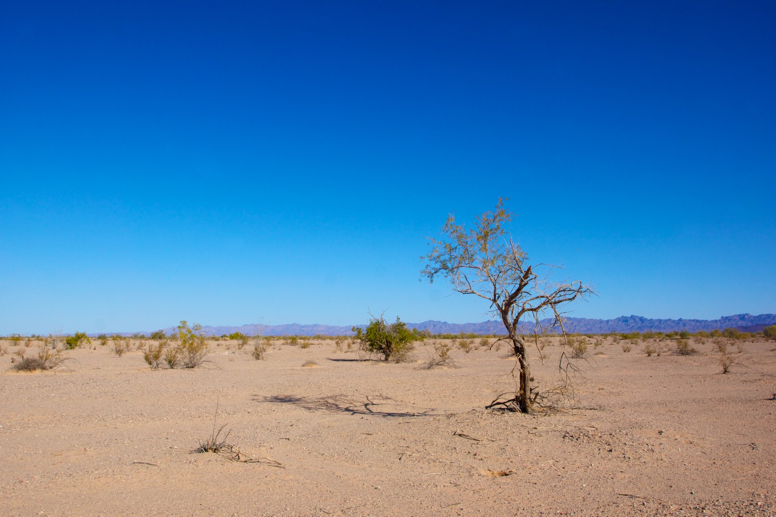

Slide 2
EGYPT

Slide 3
Pharoah
EGYPT
(Bondage)

Slide 4
Pharoah
Moses
EGYPT
(Bondage)
Passover

Slide 5
Pharoah
Moses
EGYPT
(Bondage)
Passover
WILDERNESS
(Nation)
Red Sea

Slide 6
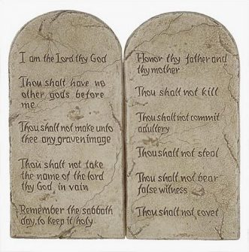
Pharoah
Moses
EGYPT
(Bondage)
Passover
WILDERNESS
(Nation)
The Law
Red Sea
Most Fell

Slide 7
Pharoah
Moses
EGYPT
(Bondage)
Passover
WILDERNESS
(Nation)
The Law
PROMISE LAND
(Rest)
Red Sea
JORDAN
Most Fell

Slide 8
Pharoah
Moses
EGYPT
(Bondage)
Passover
WILDERNESS
(Nation)
The Law
PROMISE LAND
(Rest)
Red Sea
JORDAN
Most Fell
WORLD

Slide 9
Pharoah
Moses
EGYPT
(Bondage)
Passover
WILDERNESS
(Nation)
The Law
PROMISE LAND
(Rest)
Red Sea
JORDAN
Satan
Most Fell
WORLD
(Bondage)
Romans 6:16

Slide 10
Pharoah
Moses
EGYPT
(Bondage)
Passover
WILDERNESS
(Nation)
The Law
PROMISE LAND
(Rest)
Red Sea
JORDAN
Satan
Christ
Most Fell
WORLD
(Bondage)
Romans 6:16
1 Cor 5:7

Slide 11
Pharoah
Moses
EGYPT
(Bondage)
Passover
WILDERNESS
(Nation)
The Law
PROMISE LAND
(Rest)
Red Sea
JORDAN
Satan
Christ
Most Fell
WORLD
(Bondage)
Romans 6:16
CHURCH
(Nation)
Baptism
1 Cor 5:7

Slide 12
Pharoah
Moses
EGYPT
(Bondage)
Passover
WILDERNESS
(Nation)
The Law
PROMISE LAND
(Rest)
Red Sea
JORDAN
Satan
Christ
Most Fell
WORLD
(Bondage)
Romans 6:16
CHURCH
(Nation)
New Law
Baptism
1 Cor 5:7
Jer. 31:31-34

Slide 13
“Behold the days are coming, says the Lord, when I will make a new covenant with the house of Israel and the house of Judah…I will put My Law in their minds and write it on their hearts, and I will be their God, and they shall be My people.”
Jeremiah 31:31-34

Slide 14
Pharoah
Moses
EGYPT
(Bondage)
Passover
WILDERNESS
(Nation)
The Law
PROMISE LAND
(Rest)
Red Sea
JORDAN
Satan
Christ
Most Fell
WORLD
(Bondage)
Romans 6:16
CHURCH
(Nation)
New Law
Baptism
1 Cor 5:7
Jer. 31:31-34
Some Fall

Slide 15
Pharoah
Moses
EGYPT
(Bondage)
Passover
WILDERNESS
(Nation)
The Law
PROMISE LAND
(Rest)
Red Sea
JORDAN
Satan
Christ
Most Fell
WORLD
(Bondage)
Romans 6:16
CHURCH
(Nation)
New Law
HEAVEN
(Rest)
Baptism
DEATH
1 Cor 5:7
Jer. 31:31-34
Heb 4:9,10
Some Fall

Slide 16
Book of Hebrews
Old Law
New Law
VS

Slide 17
HEAVEN
(Rest)
CHURCH
(Nation)
New Law
DEATH
Baptism
Some
will fall

Slide 18
“But you have come to Mount Zion and to the city of the Living God, the heavenly Jerusalem, to an innumerable company of angels, to the general assembly and church of the Firstborn who are registered in heaven, to God the Judge of all, to the spirits of just men made perfect, to Jesus the Mediator of the new covenant, and to the blood...” Hebrews 12:22-24
HEAVEN
(Rest)
CHURCH
(Nation)
New Law
DEATH
Baptism
Some
will fall

Slide 19
“For whatever things were written before were written for our learning, that we through the patience and comfort of the scriptures might have hope.”
Romans 15:4

